Slide 1
Modelling COVID-19 spread in Scotland: covid-eeraModel version 0.3.2
T. Porphyre
The Roslin Institute, University of Edinburgh
Scotland’s Centre of Expertise on Animal Disease Outbreaks

Slide 2
Current questions
What is the probability of infection given contact for HCW and general population?
What was/is the level of compliance for social distancing and quarantine measure?
When was the first introduction? And how many introduction?
What is the current level of community infection in the population?
What is the relative risk of death due to COVID for frail cases vs non-frail?

Slide 3
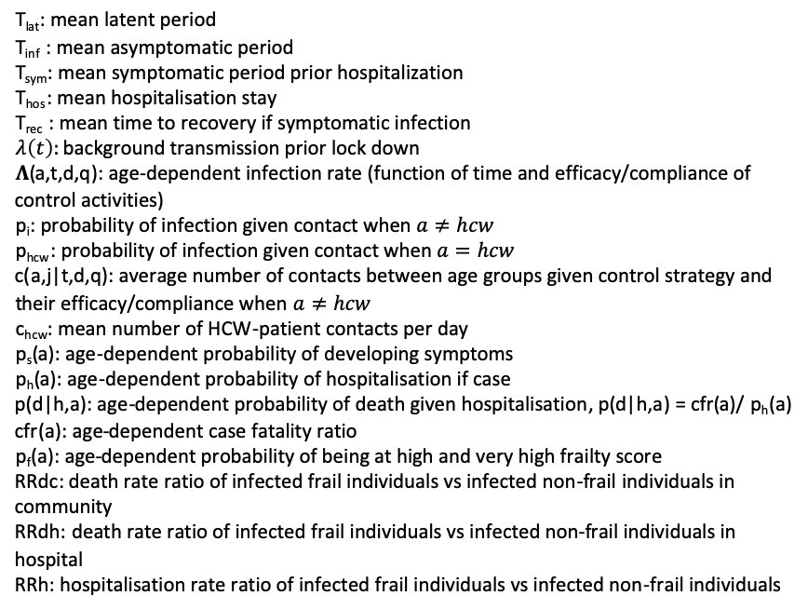
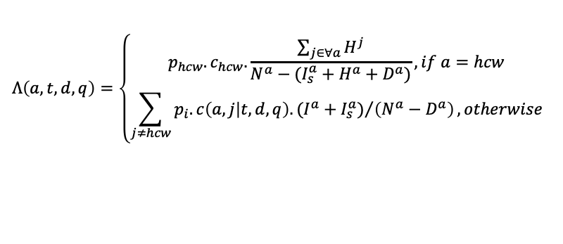
Modelling framework
I_{t}ª
Rª
Age-structured, with HCW separated population, stochastic model
(1-p_{s}(a))*(1/T_{inf})
B * (1/T_{hos})
F * (1/ T_{rec})
Sª
λ(t) + 𝚲(a,t,d,q)
Eª
1/T_{lat}
Iª
p_{s}(a)*(1/T_{inf})
I_{s}ª
(C+D) * (1/T_{sym})
Hª
T_{lat}: mean latent period
T_{inf} : mean asymptomatic period
T_{sym}: mean symptomatic period prior hospitalization
T_{hos}: mean hospitalisation stay
T_{rec} : mean time to recovery if symptomatic infection
$λ\left(t\right):$ background transmission prior lock down
𝚲(a,t,d,q): age-dependent infection rate (function of time and efficacy/compliance of control activities)
p_{i}: probability of infection given contact when $a≠hcw$
p_{hcw}: probability of infection given contact when $a=hcw$
c(a,j|t,d,q): average number of contacts between age groups given control strategy and their efficacy/compliance when $a≠hcw$
c_{hcw}: mean number of HCW-patient contacts per day
p_{s}(a): age-dependent probability of developing symptoms
p_{h}(a): age-dependent probability of hospitalisation if case
p(d|h,a): age-dependent probability of death given hospitalisation, p(d|h,a) = cfr(a)/ p_{h}(a)
cfr(a): age-dependent case fatality ratio
p_{f}(a): age-dependent probability of being at high and very high frailty score
RRdc: death rate ratio of infected frail individuals vs infected non-frail individuals in community
RRdh: death rate ratio of infected frail individuals vs infected non-frail individuals in hospital
RRh: hospitalisation rate ratio of infected frail individuals vs infected non-frail individuals
E* (2/ T_{hos})
A* (1/T_{hos})
Dª
$$Λ\left(a,t,d,q\right)=\left\{\begin{matrix}p_{hcw}.c_{hcw}.\frac{\sum_{j∈∀a}{H^{j}}}{N^{a}−(I_{s}^{a}+H^{a}+D^{a})}, if a=hcw \\ \sum_{j≠hcw}{{p_{i}.c\left(a,j | t,d,q\right).(I^{a}+I_{s}^{a})}/{\left(N^{a}−D^{a}\right)}}, otherwise\end{matrix}\right.$$
A = (p_{f}(a) * RRdh + (1 - p_{f}(a) ) ) * p(d|h,a)
B = p_{f}(a) * ( 1 - RRdh *p(d|h,a) ) +
(1 - p_{f}(a) ) * ( 1 - p(d|h,a) )
C= p_{f}(a) * RRh * p_{h}(a)
D = (1 - p_{f}(a) ) * p_{h}(a)
E = {( p_{f}(a) * (1 - RRh * p_{h}(a) ) ) * RRdc +
(1 - p_{f}(a) ) * (1 - p_{h}(a) )} * cfr(a)
E= {( p_{f}(a) - C ) * RRdc + (1 - p_{f}(a) ) - D } * cfr(a)
F = ( p_{f}(a) - C ) * (1 - RRdc * cfr(a) ) +
((1 - p_{f}(a) ) - D ) * (1 - cfr(a) )
Notes:
Note: community population infection process is normalised by the total population (excl. death). Hcw population is different as if HCW found infected, hospitalised or dead, it will be remove from the HCW population and its contact will be average out by other HCW.

Slide 4
Modelling framework
Population structure, age-specific hospitalisation rate and CFR
Assumptions:
Time to death in community will be twice as fast as in hospital.
Symptomatic Infectious individuals will self-isolate.
Self-isolated individuals will only contact a proportion q of the contacts they do at home.
HCW will self-isolate perfectly once symptomatic.
During lock-down, a proportion d of individuals will restrict their contact to within home, the rest will only not make their work and school contacts.
Number of HCW is proportional to population in each HB.
Scots contact behaviour similar to the rest of the UK.
Fixed parameters
(source: Scottish census 2011; ECDC, 2020; Russell et al 2020)
T_{lat}=5 days,
p_{s}(a>0)= 0.96
p_{s}(a=0)= 0.1 probability of symptoms p_{s} for Under 20 yo, from doi:10.1542/peds.2020-0702
T_{inf} =3 days
T_{rec} =11 days
T_{sym} =5 days
T_{hos} =5 days , from https://www.icnarc.org/Our-Audit/Audits/Cmp/Reports
p(d|h,a) = CFR(a) / p_{h}(a)
CFR(a): age-structured case fatality ratio, from doi: 10.2807/1560-7917.ES.2020.25.12.2000256
p_{h}(a): age-structured probability of hospitalisation, from https://www.ecdc.europa.eu/sites/default/files/documents/RRA-seventh-update-Outbreak-of-coronavirus-disease-COVID-19.pdf
Mean number of contact between age groups
Normal
Not work not school
Home only
(source: Prem et al 2017)

Slide 5
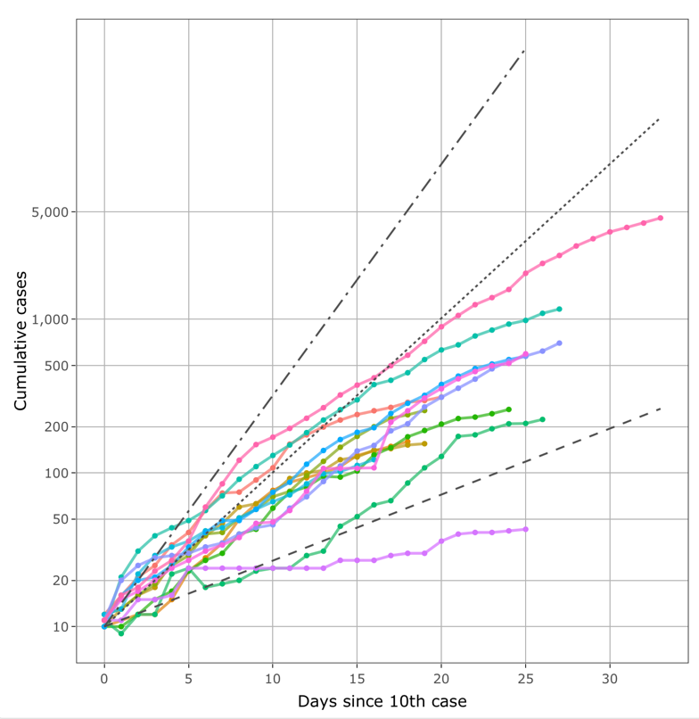
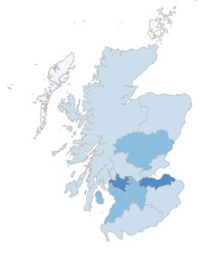
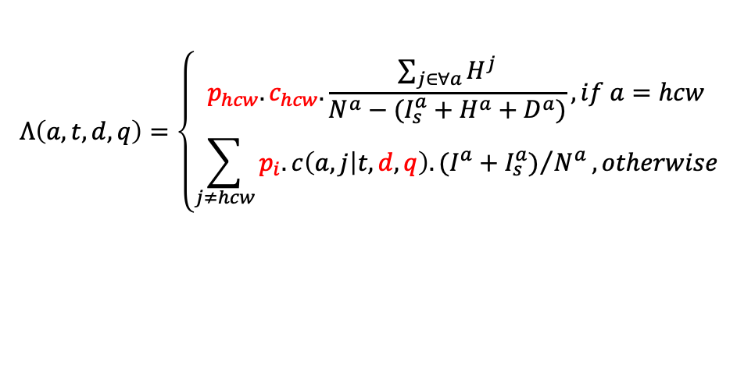
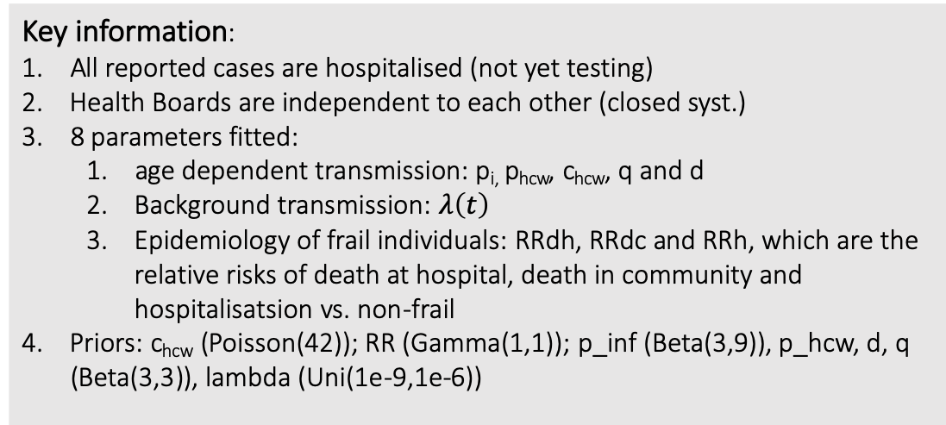
Fitting procedure
$$Λ\left(a,t,d,q\right)=\left\{\begin{matrix}p_{hcw}.c_{hcw}.\frac{\sum_{j∈∀a}{H^{j}}}{N^{a}−(I_{s}^{a}+H^{a}+D^{a})}, if a=hcw \\ \sum_{j≠hcw}{{p_{i}.c\left(a,j | t,d,q\right).(I^{a}+I_{s}^{a})}/{N^{a}}}, otherwise\end{matrix}\right.$$
Number of reported cases per day
Key information:
All reported cases are hospitalised (not yet testing)
Health Boards are independent to each other (closed syst.)
8 parameters fitted:
age dependent transmission: p_{i,} p_{hcw}, c_{hcw}, q and d
Background transmission: $λ\left(t\right)$
Epidemiology of frail individuals: RRdh, RRdc and RRh, which are the relative risks of death at hospital, death in community and hospitalisatsion vs. non-frail
Priors: c_{hcw} (Poisson(42)); RR (Gamma(1,1)); p_inf (Beta(3,9)), p_hcw, d, q (Beta(3,3)), lambda (Uni(1e-9,1e-6))
ABC-SMC inference framework

Slide 6
Goodness of fit

Slide 7
Problems encountered
Fit on both cases and deaths from NHS data not possible
Only at Scotland-level only: no data at HB-level
Model always underpredicting deaths at hospital
Seeding was fixed to index case but index != primary case
frail population to account hospital filtering
New hypothesis:
National data too messy → need HB level data
CFR(a) and ph(a) in Scotland/UK differ from literature → need fit but more statistically challenging (add 14 parameters to fit)
NHS
Model totD
NRS
Model Dh

Slide 8
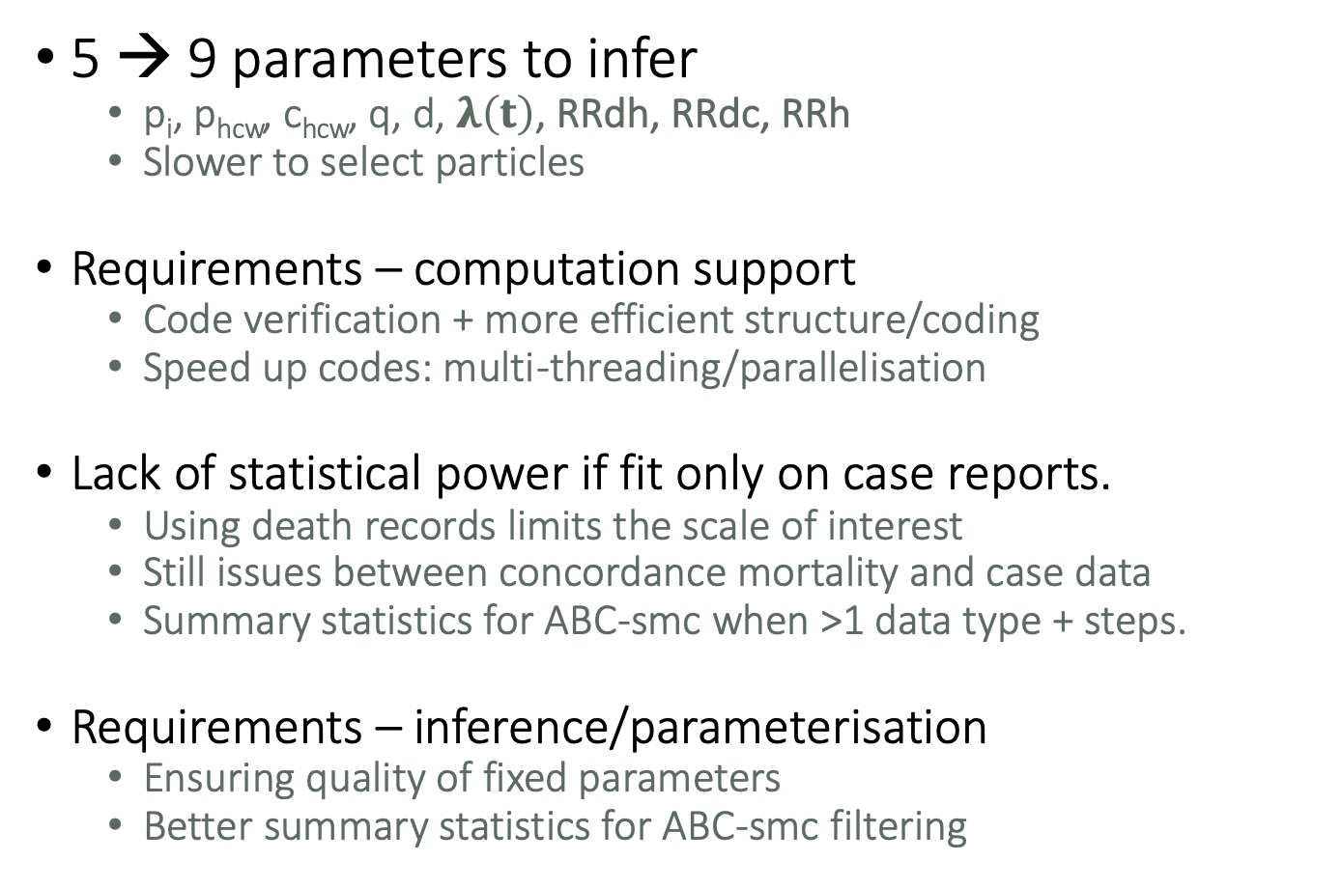
problems encountered/anticipated
5 → 9 parameters to infer
p_{i}, p_{hcw}, c_{hcw}, q, d, $λ\left(t\right)$, RRdh, RRdc, RRh
Slower to select particles
Requirements – computation support
Code verification + more efficient structure/coding
Speed up codes: multi-threading/parallelisation
Lack of statistical power if fit only on case reports.
Using death records limits the scale of interest
Still issues between concordance mortality and case data
Summary statistics for ABC-smc when >1 data type + steps.
Requirements – inference/parameterisation
Ensuring quality of fixed parameters
Better summary statistics for ABC-smc filtering

